Slide 1
Module 2: Essentials of Cloud Computing and Characteristics Learning Activities

Slide 2
Cloud Computing
Cloud computing is the delivery of computing services—including servers, storage, databases, networking, software, analytics, and intelligence—over the Internet (“the cloud”) to offer faster innovation, flexible resources, and economies of scale.
You typically pay only for cloud services you use, helping you lower your operating costs, run your infrastructure more efficiently, and scale as your business needs change.
https://azure.microsoft.com/en-au/overview/what-is-cloud-computing/#benefits

Slide 3
The NIST Definition of Cloud Computing
According to National Institute of Standards and Technology: Cloud computing is a model for enabling ubiquitous, convenient, on-demand network access to a shared pool of configurable computing resources (e.g., networks, servers, storage, applications, and services) that can be rapidly provisioned and released with minimal management effort or service provider interaction.
This cloud model is composed of five essential characteristics, three service models, and four deployment models.

Slide 4
Essential Characteristics
On-Demand Self-Service: Cloud computing allows users to automatically provision resources like computing power, storage, and networking without human intervention from the service provider.
Broad Network Access: Cloud services are accessible over the network (internet) using a variety of devices such as smartphones, laptops, and tablets. This ensures flexibility and availability.
Resource Pooling: Cloud providers use multi-tenant models to pool resources and distribute them dynamically across different users. This helps in efficient resource management and cost reduction.
Notes:
On-Demand Self-Service
Example:
Imagine you're editing a video using Canva or Adobe Premiere Online. You decide you need more storage for your project or want faster processing. With cloud, you can instantly upgrade your plan or access more power/storage by clicking a few buttons—no need to call anyone or wait for approval.
Broad Network Access
Example:
You're working on a Google Doc on your laptop at home. Later, you go out and open the same doc from your phone to continue editing. You might even review it on your iPad during commute.
🔹 The cloud lets you access the same data or app on any internet-connected device, anytime, anywhere.
Resource Pooling
Example: Think of Netflix. Millions of users stream shows at the same time, but the system doesn’t crash. That’s because Netflix uses pooled cloud resources to handle all that demand. The system adjusts and assigns resources dynamically so no one notices slowdowns.
🔹 It’s like a power grid—everyone gets electricity, but the same underlying infrastructure is shared efficiently.

Slide 5
Essential Characteristics
Rapid Elasticity: Cloud systems can quickly scale resources up or down according to demand. This elasticity ensures that users only pay for what they use, adjusting dynamically as needed.
Measured Service: Cloud computing resources are metered and billed based on usage. This pay-as-you-go model ensures that users only pay for the services they use, often based on usage metrics like compute time or storage space.
Notes:
Rapid Elasticity
Example: Imagine you run an online clothing store. During normal days, you get 100 visitors per day, but during a flash sale or festival season, you suddenly get 10,000 visitors.
With cloud hosting, your website can automatically scale up its computing resources to handle the surge in traffic—and when the sale ends, it scales back down to normal. You don’t need to manually upgrade or downgrade hardware.
🔹 It’s like Uber sending more drivers when demand increases and fewer during quiet hours—resources grow and shrink automatically.
2. Measured Service
Example: Think of Google Drive or Dropbox. If you use 5 GB of storage, you pay nothing (free tier). If you need 100 GB, you pay more. If next month you reduce your files to 20 GB, your charges drop again.
Cloud providers track how much you use (storage, bandwidth, etc.) and charge you only for that—no flat rates or wasted money.
🔹 It’s like paying your electricity bill—you’re billed for the units you consume, not a fixed amount.

Slide 6
Learning Activity 1: Race to Fill In the Five Essentials of Cloud
Post your reflection in the Module 2 discussion forum.
Access Module 2: Learning Activity 1 - Discussion Forum

Slide 7
Learning Activity 2: 📌 Cloud Adoption in Australia & New Zealand: Insights & Challenges
🎯 Key Takeaways from the Article:
- 🌏 Australia & NZ are cloud leaders but still face adoption challenges.
- 🏛️ Government policies encourage cloud growth.
- 🔒 Security, compliance & cost remain top concerns.
- 🤖 AI & automation are shaping cloud usage.

Slide 8
Difference between
Parameter | Amazon Web Services (AWS) – Elastic Compute Cloud (EC2) | Microsoft Azure – Azure AI & Machine Learning
Service Type | Infrastructure as a Service (IaaS) | Platform as a Service (PaaS)
Primary Function | Provides scalable virtual computing instances for running applications and workloads. | Offers machine learning and AI tools for building and deploying intelligent applications.
Target Customers | Businesses needing compute power for applications, websites, and big data processing. | Businesses looking to implement AI, automation, and data-driven decision-making in their operations.
Scalability | High scalability for computing power with instant provisioning of virtual servers (instances). | Scalable resources for AI model training, inference, and deployment across cloud infrastructure.
Core Benefit | Flexible and cost-efficient cloud compute capacity with a pay-as-you-go model. | Simplifies AI model development and deployment, even for those with limited expertise in AI.
Cost Model | Pay-as-you-go pricing based on the instance type and usage. | Consumption-based pricing based on resource usage for training, inferencing, and storage.
Popular Use Cases | Web hosting, app development, data processing, and high-performance computing. | Predictive analytics, data-driven decision-making, and automation via AI-powered apps.
Integration with Other Services | Can be integrated with AWS services like S3 for storage, RDS for databases, and Lambda for serverless functions. | Integrates with Azure services like Power BI for data analysis, Azure Databricks for data engineering, and Cognitive Services for pre-built AI models.
Global Availability | Available in multiple AWS regions worldwide with low latency and high redundancy. | Available globally, with data centers in multiple regions supporting hybrid cloud solutions.
Customer Experience | Self-service management via AWS Management Console, providing deep customization and flexibility. | Easy-to-use interfaces and pre-built models to accelerate AI application development, available through Azure Studio and APIs.
Notes:
Conclusion / Key Learnings:
This comparison highlights the diverse capabilities and strengths of cloud services across different layers of the cloud stack. AWS EC2, as an Infrastructure as a Service (IaaS), offers highly scalable and customizable virtual servers ideal for businesses needing computing power for applications, data processing, and hosting. It provides flexibility, control, and integration with other AWS services, following a pay-as-you-go model.
In contrast, Azure AI & Machine Learning represents Platform as a Service (PaaS), streamlining the development and deployment of intelligent applications. It caters to businesses focused on AI-driven innovation, offering scalability, pre-built models, and user-friendly interfaces—even for those with limited AI expertise.

Slide 9
Learning Activity 3: Key Cloud Computing Services Offered by the Cloud Service Provider
Cloud service providers are generally those companies that:
Establish and manage public clouds
Manage private clouds
Offer on-demand cloud computing services such as Infrastructure-as-a-Service (IaaS), Platform-as-a-Service (PaaS) and Software-as-a-Service(SaaS)
For example, Amazon Web Services (AWS), Microsoft Azure and Google Cloud Platform (GCP) are some of the well-known service providers. To get an appropriate understanding of cloud services, please watch this video about Current Major Cloud ProvidersLinks to an external site..
Now that you are more familiar with cloud service providers and services, select any two cloud service providers from AWS, Microsoft Azure, IBM Cloud or GCP and discuss at least one key service offered by them. Why do you think this key service unlocks so much value for the customer?
Post your reflection in the Module 2 discussion forum.
Access Module 2: Learning Activity 3 - Discussion Forum
Notes:
1. Amazon Web Services (AWS) – Amazon S3 (Simple Storage Service)
Key Service: Amazon S3 is a highly scalable, durable, and secure object storage service that allows users to store and retrieve any amount of data at any time, from anywhere on the web.
Why It Unlocks Value:
Scalability: Automatically scales with the customer’s needs, from a few megabytes to petabytes.
Durability & Reliability: Provides 99.999999999% (11 9s) durability by automatically replicating data across multiple facilities.
Cost-Effective: Offers a pay-as-you-go model, so businesses only pay for the storage they use.
Integration: Easily integrates with other AWS services like EC2, Lambda, and analytics tools like Athena and Redshift. This service unlocks value by giving businesses a secure, flexible, and cost-efficient way to store and manage massive volumes of data—essential for backup, disaster recovery, big data analytics, and content distribution.
2. Microsoft Azure – Azure Virtual Machines
Key Service: Azure Virtual Machines (VMs) provide on-demand, scalable computing resources for running applications just like on a physical computer.
Why It Unlocks Value:
Flexibility: Supports Windows, Linux, and many other platforms with full control over VM configurations.
Scalability: VMs can be scaled up or down based on workload requirements.
Global Reach: Offers VMs in many data center regions globally, enabling low-latency performance.
Business Continuity: VMs can be backed up and configured with failover and disaster recovery options. Azure VMs unlock value by providing reliable, customizable computing environments, ideal for hosting websites, running business-critical apps, or testing software—without the need for investing in physical servers.
Key Cloud Computing Services by Two Major Cloud Providers
3. Google Cloud Platform (GCP) – BigQuery
Key Service: BigQuery is GCP’s fully-managed, serverless data warehouse that allows users to run lightning-fast SQL queries on large datasets.
Why It Unlocks Value:
Speed & Performance: Processes terabytes of data in seconds, thanks to its highly optimized architecture.
Serverless: No infrastructure to manage—users focus solely on querying and analyzing data.
Real-Time Analytics: Supports real-time data ingestion and querying, ideal for live dashboards and decision-making.
Scalable & Cost-Efficient: Automatically scales with data volume and charges only for the queries run.
BigQuery unlocks value by making advanced analytics accessible without deep infrastructure knowledge, helping businesses make data-driven decisions quickly and at scale.
4. IBM Cloud – Watson AI
Key Service: IBM Watson is IBM Cloud’s AI platform that offers tools for building, training, and deploying AI models, including natural language processing, computer vision, and machine learning.
Why It Unlocks Value:
AI Made Accessible: Offers pre-built models and APIs for common AI tasks like chatbots, language understanding, and visual recognition.
Industry-Specific Solutions: Tailored AI services for healthcare, finance, and customer service.
Integration & Security: Easily integrates with existing IBM systems and emphasizes enterprise-grade security.
Low-Code Tools: Enables non-technical users to build intelligent solutions using Watson Studio and AutoAI.
Watson AI unlocks value by empowering businesses to innovate with AI without needing a team of data scientists, improving efficiency, customer experience, and decision-making.

Slide 10
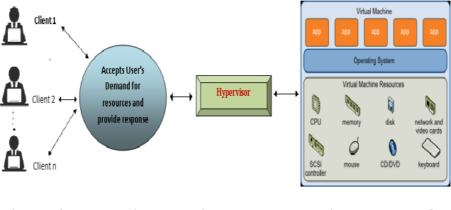
Essential Characteristics
Resource pooling.
Rashid, A., & Chaturvedi, A.K. (2017). A Study on Resource Pooling, Allocation and Virtualization Tools used for Cloud Computing. International Journal of Computer Applications, 168, 7-11.
Notes:
A hypervisor is software that creates and runs virtual machines (VMs) on a single physical machine by dividing its resources (CPU, memory, storage) among multiple users or systems. It enables virtualization, which is fundamental to cloud computing.
Why It’s Important:
Without hypervisors, cloud providers couldn’t host multiple users on the same physical machine efficiently. Hypervisors make resource sharing, isolation, and scalability possible in cloud environments.

Slide 11
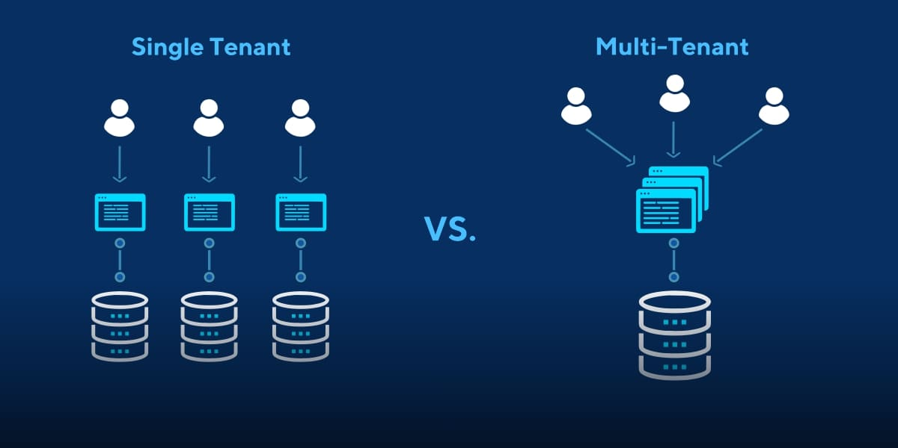
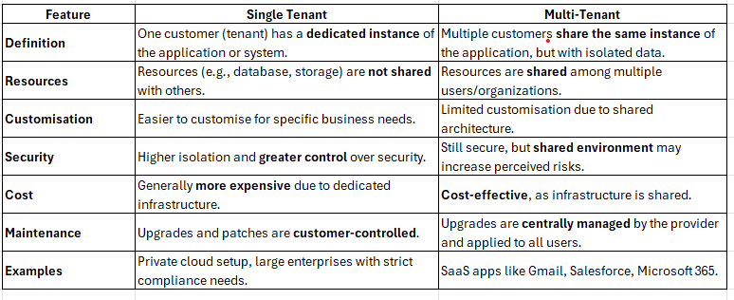
https://www.eescorporation.com/multi-tenancy-issues-in-cloud-computing/
Notes:
Single Tenant vs Multi-Tenant Architecture
Feature
Single Tenant
Multi-Tenant
Definition
One customer (tenant) has a dedicated instance of the application or system.
Multiple customers share the same instance of the application, but with isolated data.
Resources
Resources (e.g., database, storage) are not shared with others.
Resources are shared among multiple users/organizations.
Customisation
Easier to customise for specific business needs.
Limited customisation due to shared architecture.
Security
Higher isolation and greater control over security.
Still secure, but shared environment may increase perceived risks.
Cost
Generally more expensive due to dedicated infrastructure.
Cost-effective, as infrastructure is shared.
Maintenance
Upgrades and patches are customer-controlled.
Upgrades are centrally managed by the provider and applied to all users.
Examples
Private cloud setup, large enterprises with strict compliance needs.
SaaS apps like Gmail, Salesforce, Microsoft 365.

Slide 12
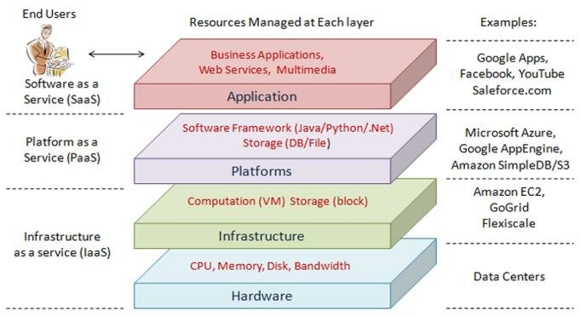
Layered cloud computing architecture
https://www.researchgate.net/figure/Layered-cloud-computing-architecture-9_fig4_265793878

Slide 13
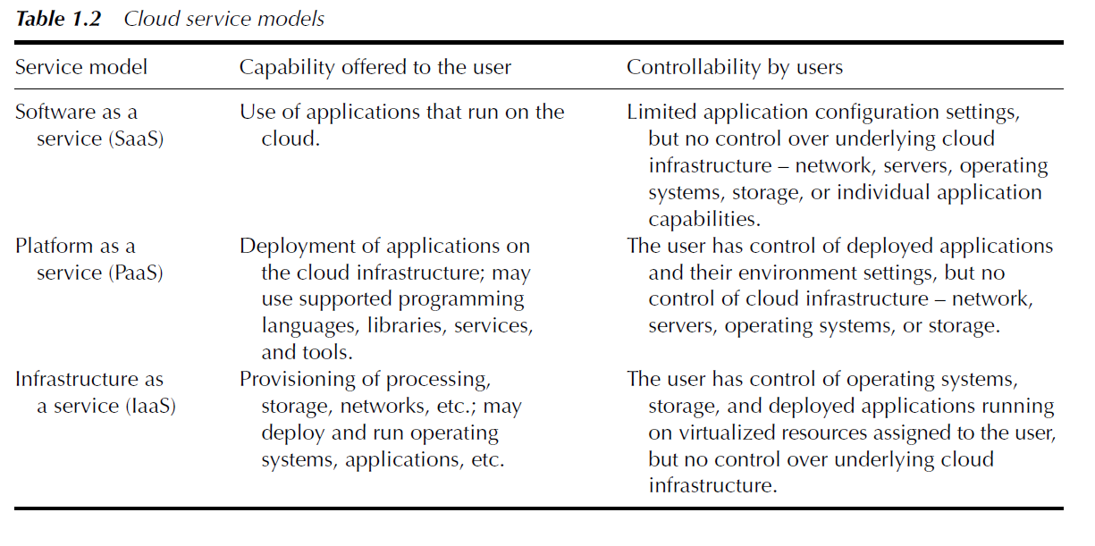
Cloud service models

Slide 14
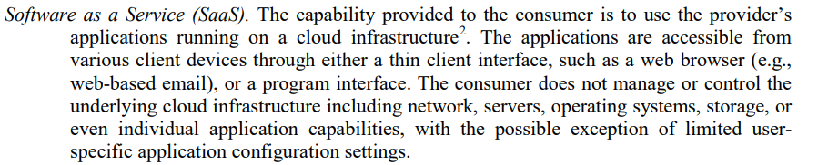
Service Models:

Slide 15
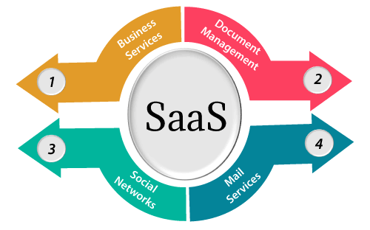
Software as a Service | SaaS
It is a software distribution model in which services are hosted by a cloud service provider.
following services provided by SaaS providers

Slide 16
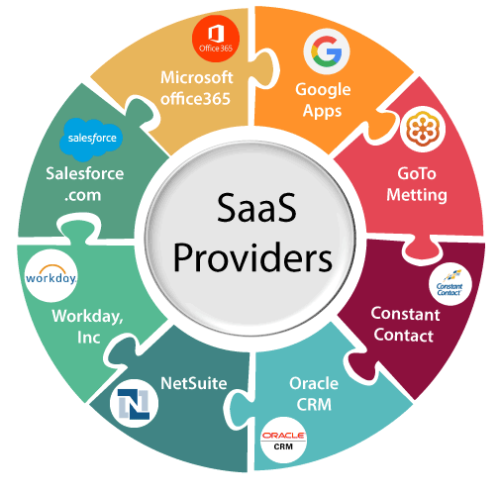
Popular SaaS Providers
https://www.javatpoint.com/software-as-a-service

Slide 17
Popular SaaS Providers
Provider | Services
Salseforce.com | On-demand CRM solutions
Microsoft Office 365 | Online office suite
Google Apps | Gmail, Google Calendar, Docs, and sites
NetSuite | ERP, accounting, order management, CRM, Professionals Services Automation (PSA), and e-commerce applications.
GoToMeeting | Online meeting and video-conferencing software
Constant Contact | E-mail marketing, online survey, and event marketing
Oracle CRM | CRM applications
Workday, Inc | Human capital management, payroll, and financial management.
https://www.javatpoint.com/software-as-a-service

Slide 18
Benefits of SaaS
The main benefit of SaaS is that it offloads all infrastructure and application management to the SaaS vendor. All the user has to do is create an account, pay the fee and start using the application. The vendor handles everything else, from maintaining the server hardware and software to managing user access and security, storing and managing data, implementing upgrades and patches and more.
Minimal risk: Many SaaS products offer a free trial period, or low monthly fees that let customers try the software to see if it will meet their needs, with little or no financial risk.
Anytime/anywhere productivity: Users can work with SaaS apps on any device with a browser and an internet connection.
Easy scalability: Adding users is as simple as registering and paying for new seats; customers can purchase more data storage for a nominal charge.
https://www.ibm.com/cloud/learn/iaas-paas-saas

Slide 19
Service Models:
Platform as a Service (PaaS). The capability provided to the consumer is to deploy onto the cloud infrastructure consumer-created or acquired applications created using programming languages, libraries, services, and tools supported by the provider. The consumer does not manage or control the underlying cloud infrastructure including network, servers, operating systems, or storage, but has control over the deployed applications and possibly configuration settings for the application-hosting environment.

Slide 20
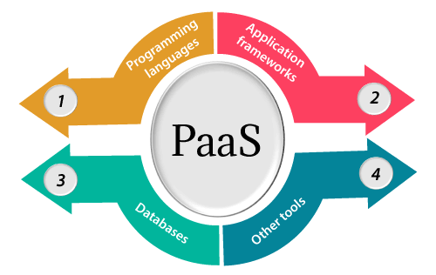
Platform as a Service | PaaS
Platform as a Service (PaaS) provides a runtime environment. It allows programmers to easily create, test, run, and deploy web applications.

Slide 21
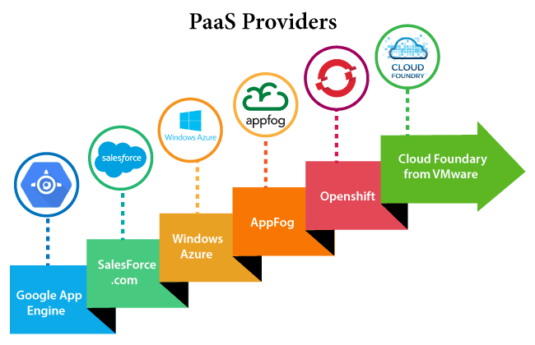
Popular PaaS Providers

Slide 22
Popular PaaS Providers
Providers | Services
Google App Engine (GAE) | App Identity, URL Fetch, Cloud storage client library, Logservice
Salesforce.com | Faster implementation, Rapid scalability, CRM Services, Sales cloud, Mobile connectivity, Chatter.
Windows Azure | Compute, security, IoT, Data Storage.
AppFog | Justcloud.com, SkyDrive, GoogleDocs
Openshift | RedHat, Microsoft Azure.
Cloud Foundry from VMware | Data, Messaging, and other services.

Slide 23
Benefits of PaaS
The primary benefit of PaaS is that it allows customers to build, test, deploy run, update and scale applications more quickly and cost-effectively than they could if they had to build out and manage their own on-premises platform.
Faster time to market: PaaS enables development teams to spin-up development, testing and production environments in minutes, vs. weeks or months.
Low- to no-risk testing and adoption of new technologies: PaaS platforms typically include access to a wide range of the latest resources up and down the application stack. This allows companies to test new operating systems, languages, and other tools without having to make substantial investments in them, or in the infrastructure required to run them.
https://www.ibm.com/cloud/learn/iaas-paas-saas

Slide 24
Benefits of SaaS
Simplified collaboration: As a cloud-based service, PaaS provides a shared software development environment, giving development and operations teams access to all the tools they need, from anywhere with an Internet connection.
A more scalable approach: With PaaS, organizations can purchase additional capacity for building, testing, staging and running applications whenever they need it.
Less to manage: PaaS offloads infrastructure management, patches, updates and other administrative tasks to the cloud service provider.
https://www.ibm.com/cloud/learn/iaas-paas-saas

Slide 25
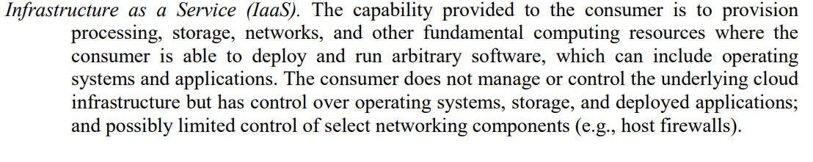
Service Models:

Slide 26
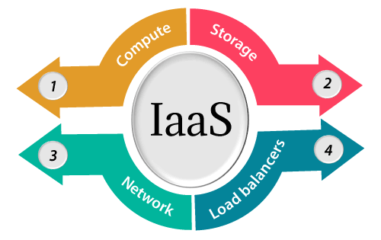
Infrastructure as a Service | IaaS
It allows customers to outsource their IT infrastructures such as servers, networking, processing, storage, virtual machines, and other resources. Customers access these resources on the Internet using a pay-as-per use model.

Slide 27
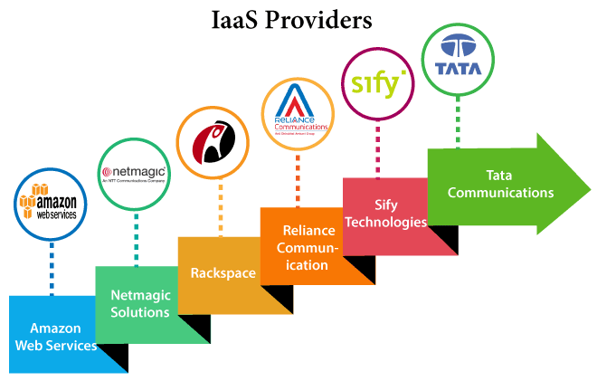
Iaas Providers
IaaS Vendor | Iaas Solution | Details
Amazon Web Services | Elastic, Elastic Compute Cloud (EC2) MapReduce, Route 53, Virtual Private Cloud, etc. | The cloud computing platform pioneer, Amazon offers auto scaling, cloud monitoring, and load balancing features as part of its portfolio.

Slide 28
Benefits of IaaS
Compared to traditional IT, IaaS gives customers more flexibility build out computing resources as needed, and to scale them up or down in response to spikes or slow-downs in traffic.
IaaS lets customers avoid the up-front expense and overhead of purchasing and maintaining its own on-premises data center.
It also eliminates the constant trade-off between the waste of purchasing excess on-premises capacity to accommodate spikes, versus the poor performance or outages that can result from not having enough capacity for unanticipated traffic bursts or growth.
https://www.ibm.com/cloud/learn/iaas-paas-saas

Slide 29
Benefits of IaaS
Higher availability: With IaaS a company can create redundant servers easily, and even create them in other geographies to ensure availability during local power outages or physical disasters.
Lower latency, improved performance: Because IaaS providers typically operate data centers in multiple geographies, IaaS customers can locate apps and services closer to users to minimize latency and maximize performance.
Improved responsiveness. Customers can provision resources in a matter of minutes, test new ideas quickly and quickly roll out new ideas to more users.
https://www.ibm.com/cloud/learn/iaas-paas-saas

Slide 30
Benefits of IaaS
Comprehensive security. With a high-level of security on-site, at data centers, and via encryption, organizations can often take advantage of more advanced security and protection they could provide if they hosted the cloud infrastructure in-house.
Faster access to best-of-breed technology. Cloud providers compete with each other by providing the latest technologies to their users, IaaS customers can take advantage of these technologies much earlier (and at far less cost) than they can implement them on premises.
https://www.ibm.com/cloud/learn/iaas-paas-saas

Slide 31
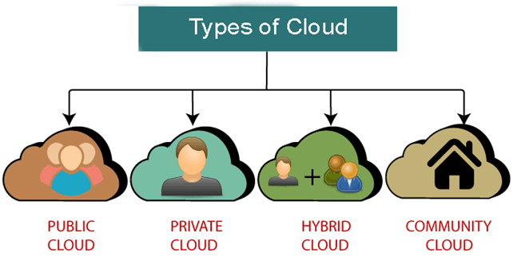
Deployment Models
https://www.javatpoint.com/types-of-cloud

Slide 32
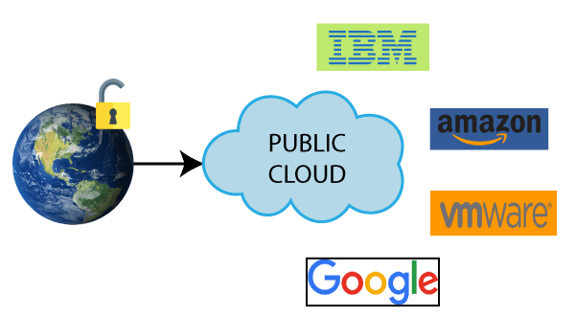
Public Cloud
Public cloud is open to all to store and access information via the Internet using the pay-per-usage method.
Example: Amazon elastic compute cloud (EC2), IBM SmartCloud Enterprise, Microsoft, Google App Engine, Windows Azure Services Platform.

Slide 33
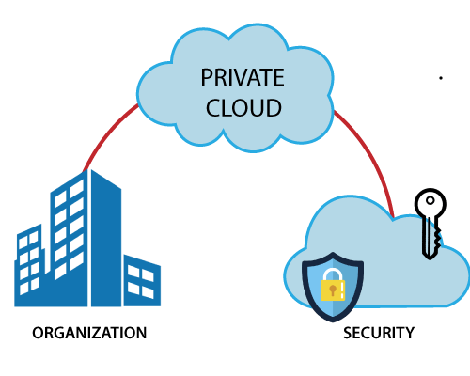
Private Cloud
Private cloud is also known as an internal cloud or corporate cloud. It is used by organizations to build and manage their own data centers internally or by the third party

Slide 34
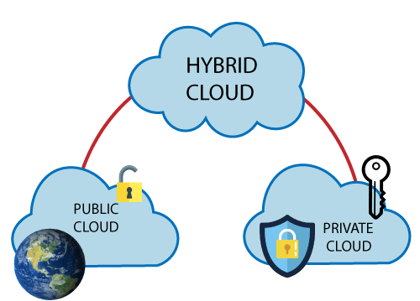
Hybrid Cloud
Hybrid Cloud = Public Cloud + Private Cloud
Example: Google Application Suite (Gmail, Google Apps, and Google Drive), Office 365 (MS Office on the Web and One Drive), Amazon Web Services.

Slide 35
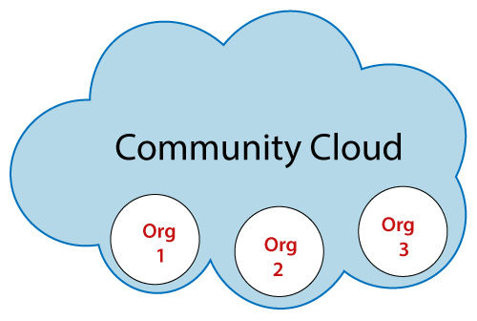
Community Cloud
Community cloud allows systems and services to be accessible by a group of several organizations to share the information between the organization and a specific community.
It is owned, managed, and operated by one or more organizations in the community, a third party, or a combination of them. Example: Health Care community cloud

Slide 36
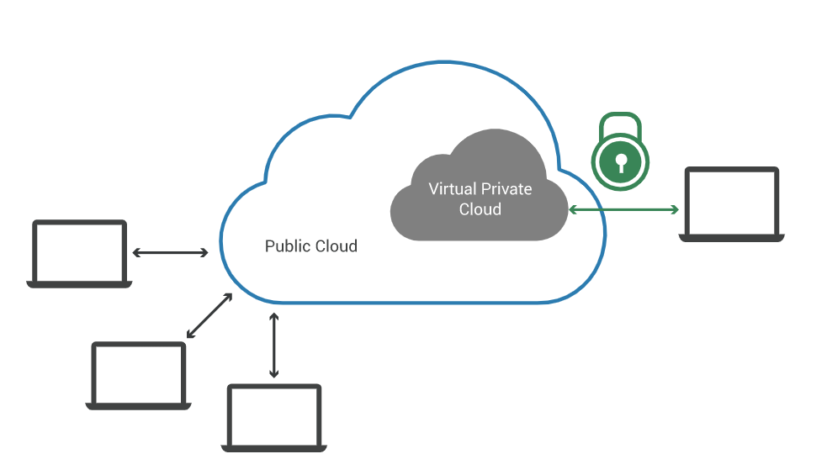
virtual private cloud (VPC)?
A virtual private cloud (VPC) is a secure, isolated private cloud hosted within a public cloud. VPC customers can run code, store data, host websites, and do anything else they could do in an ordinary private cloud, but the private cloud is hosted remotely by a public cloud provider

Slide 37
Cloud Support Services
To facilitate transition to the cloud, a cloud ecosystem is emerging that aims to offer a spectrum of new cloud support services that augment, complement, or assist the popular SaaS, IaaS, and PaaS offerings.
Examples of such cloud support services are data storage as a service (DSaaS), analytics as service (AaaS), desktop as a service (DAAS), security as a service (SecaaS), identity and access management as a service (IAMaaS), and monitoring as a service (MaaS).

Slide 38
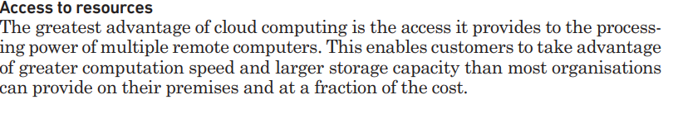
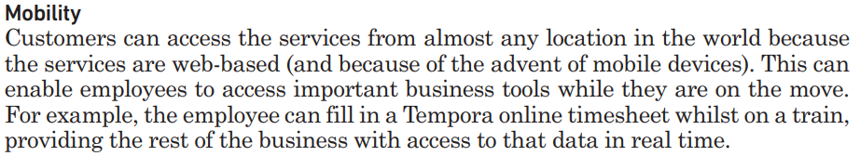
Advantages of cloud computing

Slide 39
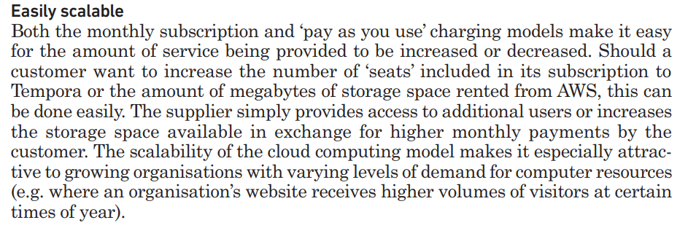
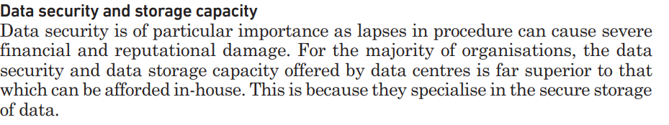
Advantages of cloud computing

Slide 40

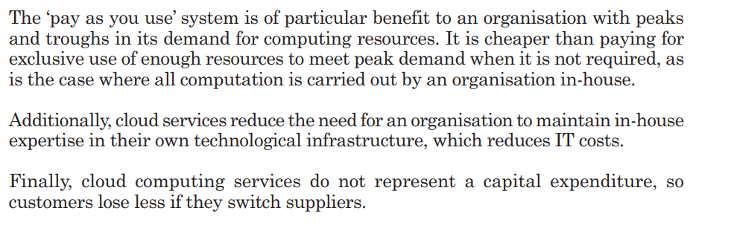
Advantages of cloud computing

Slide 41
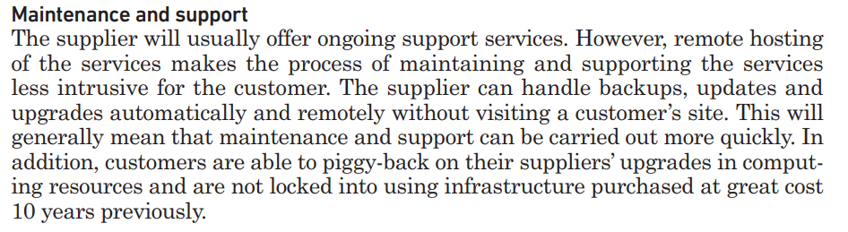
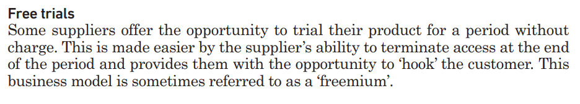
Advantages of cloud computing

Slide 42
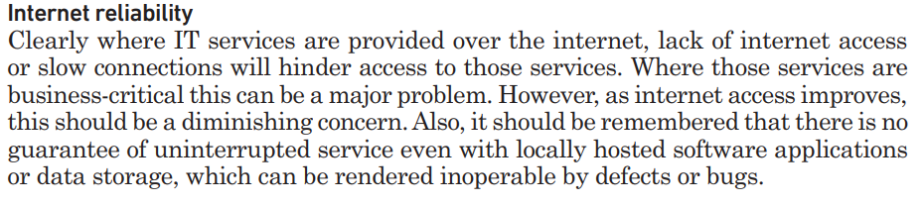
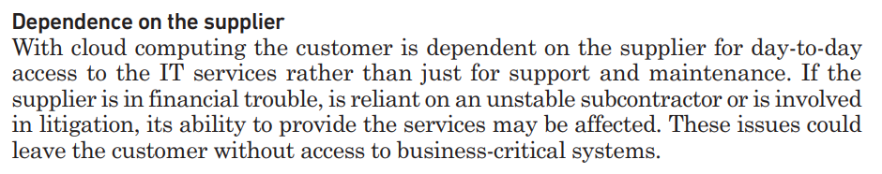
Disadvantages of cloud computing

Slide 43
ADDITIONAL SERVICE MODELS
Database as a Service:
DbaaS provides a database platform organizations can use to store their data.
Many PaaS providers also provide database services.
Desktop as a Service
DaaS provides users with a virtual desktop that can be used to perform desktop computing.

Slide 44


